Slide 1
First Generation Refugee Families in United States
By Abdullah Hassan

Slide 2
Context, Motivation, Method
As per the United Nations, 80+ million people displaced by the end of 2020.
Due to increase in Conflict, violence, persecution and human rights violations.
We’ll be looking at trends of Refugee families that resettled in the U.S overtime.
I’m one of lucky Somali Refugees that resettled in U.S(2004) as a Child.
Data Analysis Method- Get Data-Cleaning and visuals in Excel & Power Bi.
“Only leave home when a home doesn’t let you stay.”-Somali poet Warsan Shire

Slide 3
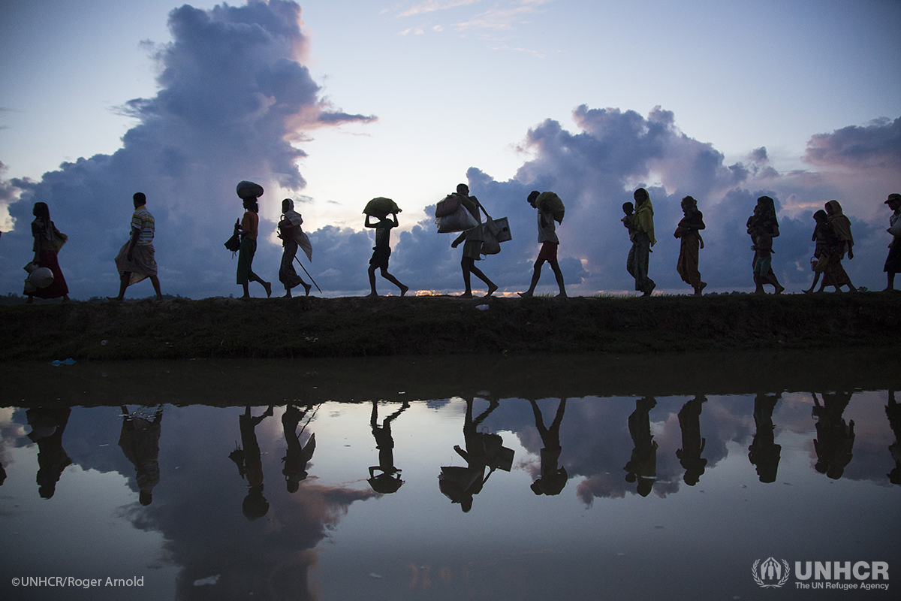
Journey Of A Refugee
Refugee will first likely Flee to neighboring host Countries.
Most end up in a refugee Camp.
Some are sent back to his/her home country as Voluntary Repatriation.
One 1% get to resettle in third country like U.S for Opportunities.
Since 1980, the U.S. has resettled more refugees than other country.

Slide 4
U.S. Refugee Ceiling & Resettlement 1980-2020

Slide 5
Top 10 countries
U.S resettled people from Somalia.
People fleeing due to long Civil War.
Resettlement Process is not easy.
Only some are approved to resettle.
Caseworker and volunteers assigned to the case; arrangements made for housing, furniture, and food.
It’s is a great sign of relief indeed.

Slide 6
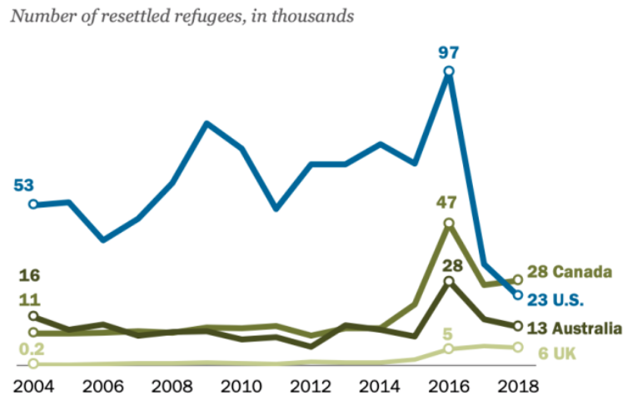
U.S. refugee resettlement drop
https://www.weforum.org/agenda/2019/06/canada-now-leads-the-world-in-refugee-resettlement-surpassing-the-u-s/

Slide 7
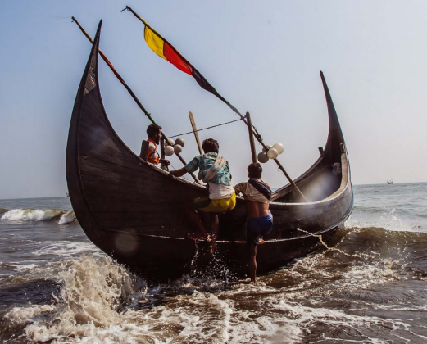
Refugees Resilience and Struggles
Refugees face challenges fleeing their home.
By land, sea, or air with only their lives.
In search for a place that offer safety etc.
Refugees suffer from (PTSD) especially kids.
Some have horror stories we can’t imagine.
They still strive to carry on with their lives.
These that get opportunity to resettle in U.S strive to integrate and give back in many ways.

Slide 8

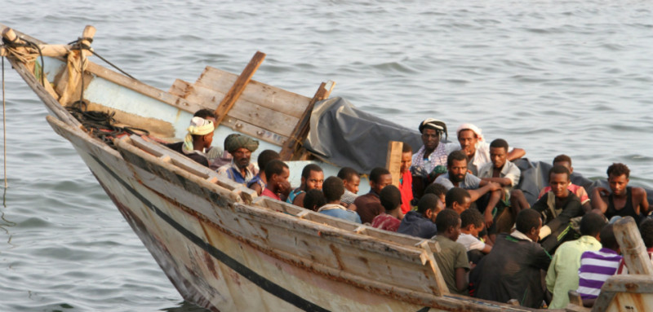
Finding and Recommendations
U.S is known to be top of Countries with the funding to Resettle more Refugees.
Canada resettled more refugees(28,100) in 2018, since the U.S 1980 Refugee Act.
Its time to get back the lead for U.S.
Improve Health Care and Education programs that’s more geared towards immigrant families, especially refugees.
More options for Voluntary Return for refugees that can rebuild their countries.

Slide 9




Local and International Refugee Agencies
Local
International

Slide 10
Reference & Articles
https://www.wrapsnet.org/admissions-and-arrivals/
https://www.migrationpolicy.org/proghttps://immigrationforum.org/article/fact-sheet-u-s-refugee-resettlement/rams/data-hub/charts/immigrant-population-over-time
https://www.dhs.gov/immigration-statistics/refugees-asylees
https://www.weforum.org/agenda/2019/06/canada-now-leads-the-world-in-refugee-resettlement-surpassing-the-u-s/
https://refugees.org/as-a-former-refugee-i-am-part-of-americas-story/
https://www.weforum.org/agenda/2019/01/from-a-refugee-camp-to-davos-one-co-chair-s-story
Thank you!

